Slide 1

@R_Trotta
Bayesian Model Comparison &
Bayesian Hierachical Models
Roberto Trotta - www.robertotrotta.com
Stats4Astro 2017
Autrans, Oct 2017

Slide 2
Frequentist Hypothesis Testing
Warning: frequentist hypothesis testing (e.g., likelihood ratio test) cannot be interpreted as a statement about the probability of the hypothesis!
Example: to test the null hypothesis H0: θ = 0, draw n normally distributed points (with known variance σ²). The χ² is distributed as a chi-square distribution with (n-1) degrees of freedom (dof). Pick a significance level α (or p-value, e.g. α = 0.05). If P(χ² > χ²obs) < α reject the null hypothesis.
This is a statement about the likelihood of observing data as extreme or more extreme than have been measured assuming the null hypothesis is correct.
It is not a statement about the probability of the null hypothesis itself and cannot be interpreted as such! (or you’ll make gross mistakes)
The use of p-values implies that a hypothesis that may be true can be rejected because it has not predicted observable results that have not actually occurred. (Jeffreys, 1961)

Slide 3
Exercise: Is the coin fair? [Stopping Rule Problem]
Divide students in team of 3-4 students each
Half of the teams are Red, half are Blue
Blue Team: N=12 is fixed, H the random variable
Red Team: H=3 is fixed, N the random variable
Data: T T H T H T T T T T T H
Question: What is the p-value for the null hypothesis?

Slide 4
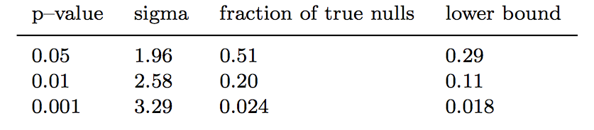
The Significance of “Significance"
Important: A 2-sigma result does not wrongly reject the null hypothesis 5% of the time: at least 29% of 2-sigma results are wrong!
Take an equal mixture of H0, H1
Simulate data, perform hypothesis testing for H0
Select results rejecting H0 at (or within a small range from) 1-α CL (this is the prescription by Fisher)
What fraction of those results did actually come from H0 ("true nulls", should not have been rejected)?
Recommended reading: Sellke, Bayarri & Berger, The American Statistician, 55, 1 (2001)

Slide 5
Bayesian Model Comparison

Slide 6
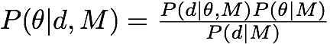
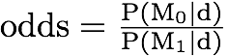
The 3 Levels of Inference
LEVEL 1
I have selected a model M
and prior P(θ|M)
LEVEL 2
Actually, there are several possible models: M0, M1,...
LEVEL 3
None of the models
is clearly the best
Parameter inference
What are the favourite values of the parameters? (assumes M is true)
Model comparison
What is the relative plausibility of M0, M1,... in light of the data?
Model averaging
What is the inference on the parameters accounting for model uncertainty?
Notes:
P(\theta | d, M) = \frac{P(d|\theta, M) P(\theta | M)}{P(d|M)}
\rm{odds} = \frac{P(M_0 | d)}{P(M_1|d)}
P(\theta | d) = \sum_i P(M_i|d) P(\theta | d, M_i)

Slide 7
Model Comparison Questions
ASTROPARTICLE
Gravitational waves detection
Do cosmic rays correlate with AGNs?
Which SUSY model is ‘best’?
Is there evidence for DM modulation?
Is there a DM signal in gamma ray/neutrino data?
COSMOLOGY
Is the Universe flat?
Does dark energy evolve?
Are there anomalies in the CMB?
Which inflationary model is ‘best’?
Is there evidence for modified gravity?
Are the initial conditions adiabatic?
Many scientific questions are of the model comparison type
ASTROPHYSICS
Exoplanets detection
Is there a line in this spectrum?
Is there a source in this image?

Slide 8
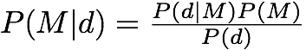
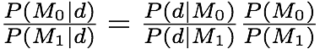
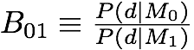
Level 2 Inference: Model Comparison
Bayesian evidence or model likelihood
The evidence is the integral of the likelihood over the prior:
Bayes’ Theorem delivers the model’s posterior:
When we are comparing two models:
The Bayes factor:
Posterior odds = Bayes factor × prior odds
Notes:
P(d|M) = \int_\Omega d\theta P(d|\theta, M)P(\theta|M)
P(M|d) = \frac{P(d|M)P(M)}{P(d)}
\frac{P(M_0|d)}{P(M_1|d)} = \frac{P(d|M_0)}{P(d|M_1)}\frac{P(M_0)}{P(M_1)}
B_{01} \equiv \frac{P(d|M_0)}{P(d|M_1)}

Slide 9
Strength of Evidence
A (slightly modified) Jeffreys’ scale to assess the strength of evidence
|lnB| | relative odds | favoured model’s probability | Interpretation
< 1.0 | < 3:1 | < 0.750 | not worth mentioning
< 2.5 | < 12:1 | 0.923 | weak
< 5.0 | < 150:1 | 0.993 | moderate
> 5.0 | > 150:1 | > 0.993 | strong

Slide 10
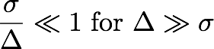
An Automatic Occam’s Razor
MLE
Likelihood
Occam’s factor: wasted parameter space under the prior
σ
Prior
Δ
Notes:
P(d|M) & = \int d\theta L(\theta)P(\theta|M) \\ & \approx P(\hat{\theta}) \delta\theta L(\hat{\theta}) \\ & \approx \frac{\delta\theta}{\Delta\theta} L(\hat{\theta})
\hat{\theta}

Slide 11
The Evidence as Predictive Probability
The evidence can be understood as a function of d to give the predictive probability under the model M:
If the observed data are here: M0 favoured
If the observed data are here: M1 favoured
P(d|M)
Simpler model M0
More complex model M1
d

Slide 12
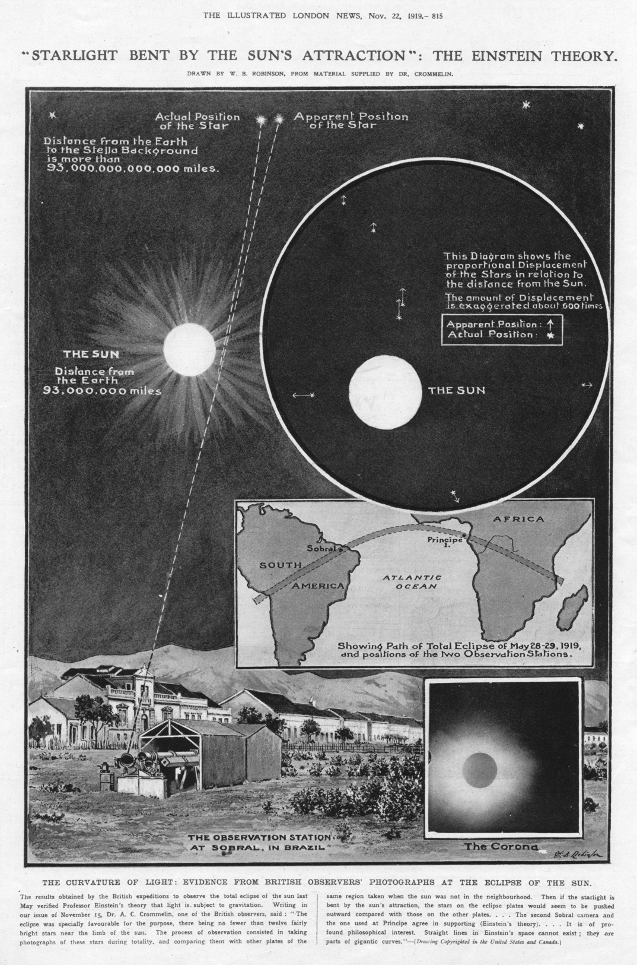
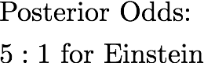
The Logic of Science
1919
Popper: “science proceeds by falsifying null hypotheses” (hypothesis testing, p-value)
Jaynes: “a successful prediction [failure to falsify] ought to be rewarded” (model comparison, Bayes Factor)
Einstein: “everything should be as simple as possible, but not simpler” (Occam’s razor)
Notes:
P(d|M) & = \int d\theta L(\theta)P(\theta|M) \\ & \approx P(\hat{\theta}) \delta\theta L(\hat{\theta}) \\ & \approx \frac{\delta\theta}{\Delta\theta} L(\hat{\theta})
\hat{\theta}

Slide 13
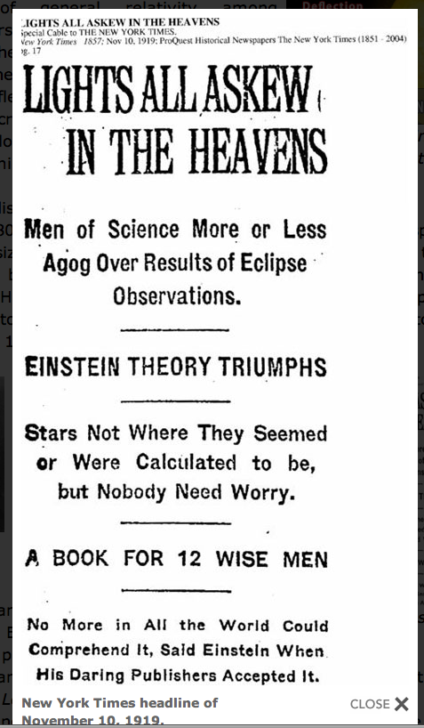

Slide 14
Simple Example: Nested Models
This happens often in practice: we have a more complex model, M1 with prior P(θ|M1), which reduces to a simpler model (M0) for a certain value of the parameter, e.g. θ = θ* = 0 (nested models)
Is the extra complexity of M1 warranted by the data?
Likelihood
σ
Prior
Δ
θ* = 0

Slide 15
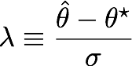
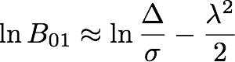
Simple Example: Nested Models
Define:
Likelihood
For “informative” data (i.e., Δ>> σ):
σ
Prior
Δ
wasted parameter space
(favours simpler model)
mismatch of prediction with observed data (favours more complex model)
θ* = 0

Slide 16
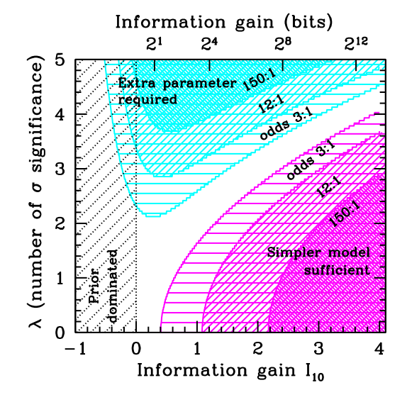
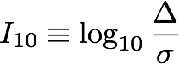
The Rough Guide to Model Comparison
wider prior (fixed data)
larger sample (fixed σ and Δ)
Planck
WMAP3
Δ = Prior width
σ = Likelihood width
WMAP1
R. Trotta (2008), Contemporary Physics, 49, No. 2, March-April 2008, 71-104, e-print archive: 0803.4089,
Notes:
I_{10} \equiv \log_{10} \frac{\Delta \theta}{\delta\theta}

Slide 17
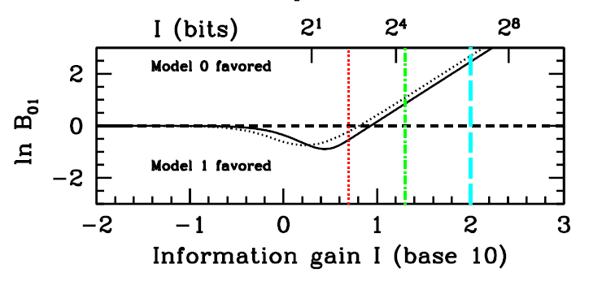
“Prior-free” Evidence Bounds
What if we do not know how to set the prior? For nested models, we can still choose a prior that will maximise the support for the more complex model:
wider prior (fixed data)
larger sample (fixed prior and significance)
maximum evidence for Model 1

Slide 18
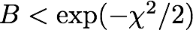
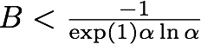
Maximum Evidence for a Detection
The absolute upper bound: put all prior mass for the alternative onto the observed maximum likelihood value. Then
More reasonable class of priors: symmetric and unimodal around Ψ=0, then (α = significance level)
If the upper bound is small, no other choice of prior will make the extra parameter significant.
For details, see: Sellke, Bayarri & Berger, The American Statistician, 55, 1 (2001)
Notes:
B < \frac{-1}{\exp(1) \alpha \ln \alpha}
B < \exp(-\chi^2/2)

Slide 19
How to Interpret the “Number of σ”
α | sigma | Absolute bound on lnB (B) | “Reasonable” bound on lnB (B)
0.05 | 2 | 2.0 (7:1) weak | 0.9 (3:1) undecided
0.003 | 3 | 4.5 (90:1) moderate | 3.0 (21:1) moderate
0.0003 | 3.6 | 6.48 (650:1) strong | 5.0 (150:1) strong

Slide 20
How to Assess p-values
Rule of thumb:
interpret a n-sigma result as a (n-1)-sigma result
Sellke, Bayarri & Berger, The American Statistician, 55, 1 (2001)

Slide 21
Computational Aspects

Slide 22
Computing the Model Likelihood
Model likelihood:
Bayes factor:
Usually computational demanding: it’s a multi-dimensional integral, averaging the likelihood over the (possibly much wider) prior
I’ll present two methods used by cosmologists:
Savage-Dickey density ratio (Dickey 1971): Gives the Bayes factor between nested models (under mild conditions). Can be usually derived from posterior samples of the larger (higher D) model.
Nested sampling (Skilling 2004): Transforms the D-dim integral in 1D integration. Can be used generally (within limitations of the efficiency of the sampling method adopted).
There are many others. One recent clever idea to re-use MCMC samples to estimate the evidence is presented in Heavens et al, arXiv:1704.03472
For a method that sidesteps the need to compute the evidence explicitly, see Hee et al, Mon.Not.Roy.Astron.Soc. 455 (2016) no.3, 2461-2473, arXiv:1506.09024

Slide 23
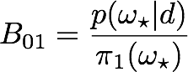
The Savage-Dickey Density Ratio
Dickey J. M., 1971, Ann. Math. Stat., 42, 204
This method works for nested models and gives the Bayes factor analytically.
Assumptions:
Nested models: M1 with parameters (Ψ,𝜔) reduces to M0 for e.g. 𝜔=𝜔✶
Separable priors: the prior π1(Ψ,𝜔|M1) is uncorrelated with π0(Ψ|M0)
Result:
Marginal posterior
under M1
The Bayes factor is the ratio of the normalised (1D) marginal posterior on the additional parameter in M1 over its prior, evaluated at the value of the parameter for which M1 reduces to M0.
Prior
𝜔 = 𝜔✶
Notes:
B_{01} = \frac{P(\Psi=0|d,M_1)}{P(\Psi=0|M_1)}

Slide 24
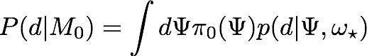
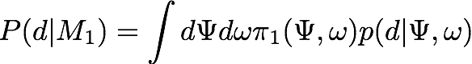
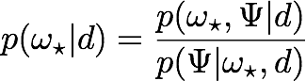
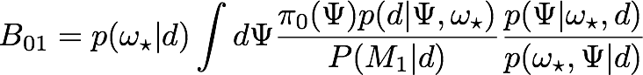
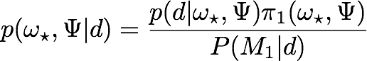
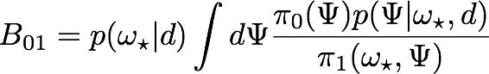
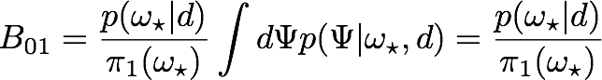
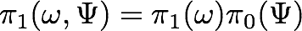
Derivation of the SDDR
RT, Mon.Not.Roy.Astron.Soc. 378 (2007) 72-82
Divide and multiply B01 by:
Since:
Assuming separable priors:
Notes:
B_{01} = \frac{P(\Psi=0|d,M_1)}{P(\Psi=0|M_1)}

Slide 25
SDDR: Some Comments
For separable priors (and nested models), the common parameters do not matter for the value of the Bayes factor
No need to spend time/resources to average the likelihoods over the common parameters
Role of the prior on the additional parameter is clarified: the wider, the stronger the Occam’s razor effect (due to dilution of the predictive power of model 1)
Sensitivity analysis simplified: only the prior/scale on the additional parameter between the models needs to be considered.
Notice: SDDR does not assume Gaussianity, but it does require sufficiently detailed sampling of the posterior to evaluate reliably its value at 𝜔=𝜔✶.
Good
Bad
?
𝜔 = 𝜔✶
𝜔 = 𝜔✶

Slide 26
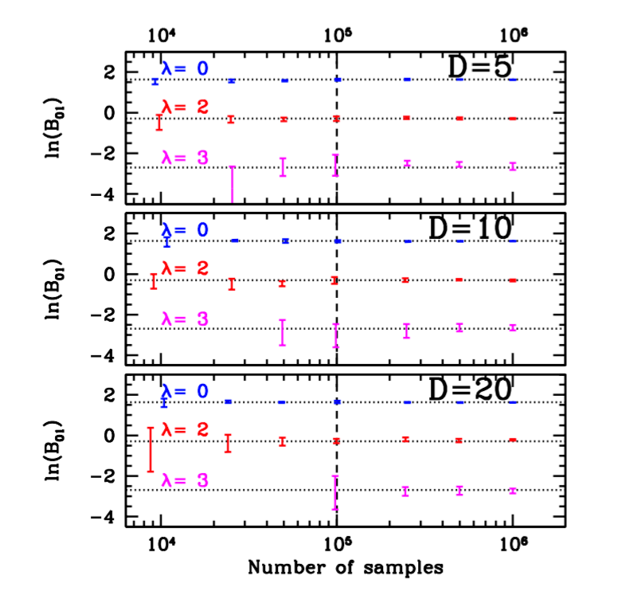
Accuracy Tests (Normal case)
Tests with variable dimensionality (D) and number of MCMC samples
λ is the distance of peak posterior from 𝜔✶ in units of posterior std dev
SDDR accurate with standard MCMC sampling up to 20-D and λ=3
Accurate estimates further in the tails might required dedicated sampling schemes
λ = (𝜔ML-𝜔✶)/σ
RT, MNRAS, 378, 72-82 (2007)
𝜔 = 𝜔✶

Slide 27
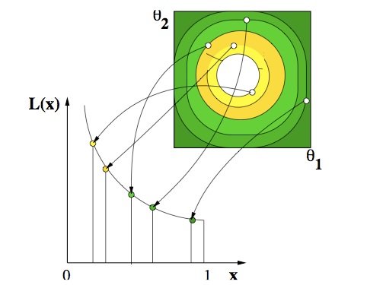
Nested Sampling
Proposed by John Skilling in 2004: the idea is to convert a D-dimensional integral in a 1D integral that can be done easily.
As a by-product, it also produces posterior samples: model likelihood and parameter inference obtained simultaneously
L(X) = likelihood value for iso-likelihood contour enclosing X prior fraction
Mukherjee+06
X = Prior fraction

Slide 28
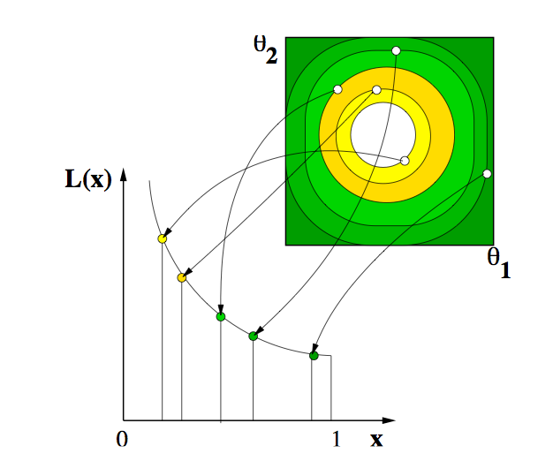
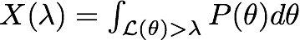
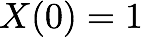
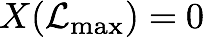
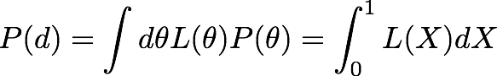
Nested Sampling Basics
Skilling, AIP Conf.Proc. 735, 395 (2004); doi: 10.1063/1.1835238
Define X(λ) as the prior mass associated with likelihood values above λ
This is a decreasing function of λ:
dX is the prior mass associated with likelihoods [λ, λ+dλ]
An infinitesimal interval dX contributes λdx to the evidence, so that:
where L(X) is the inverse of X(λ).

Slide 29
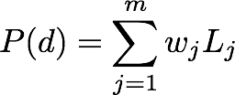
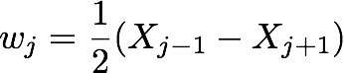
Nested Sampling Basics
Suppose that we can evaluate Lj = L(Xj), for a sequence:
Then the model likelihood P(d) can be estimated numerically as:
with a suitable set of weights, e.g. for the trapezium rule:

Slide 30
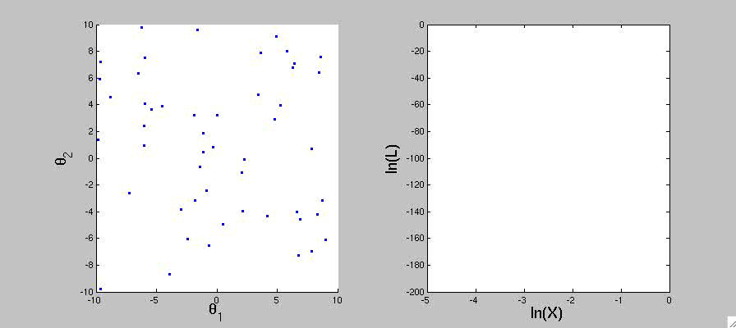
Nested Sampling in Action
(animation courtesy of David Parkinson)
2D parameter space (uniform priors)
1D model likelihood integral
X = Prior fraction

Slide 31
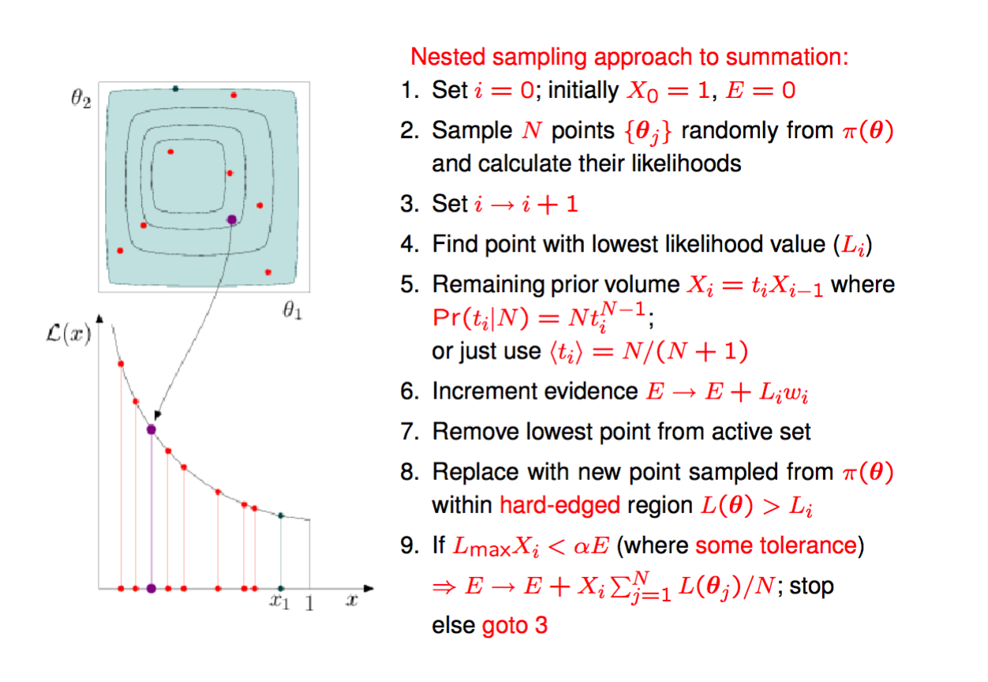
MultiNest Sampling Approach
(Slide courtesy of Mike Hobson)
Hard!

Slide 32
Nested Sampling: Sampling Step
The hardest part is to sample uniformly from the prior subject to the hard constraint that the likelihood needs to be above a certain level.
Many specific implementations of this sampling step:
Single ellipsoidal sampling (Mukherjee+06)
Metropolis nested sampling (Sivia&Skilling06)
Clustered and simultaneous ellipsoidal sampling (Shaw+07)
Ellipsoidal sampling with k-means (Feroz&Hobson08)
Rejection sampling (MultiNest, Feroz&Hobson09)
Diffusion nested sampling (Brewer+09)
Artificial neural networks (Graff+12)
Galilean Sampling (Betancourt11; Feroz&Skilling13)
Simultaneous ellipsoidal sampling with X-means (DIAMONDS, Corsaro&deRidder14)
Slice Sampling Nested Sampling (PolyChord, Handley+15)
… there will be others, no doubt.

Slide 33
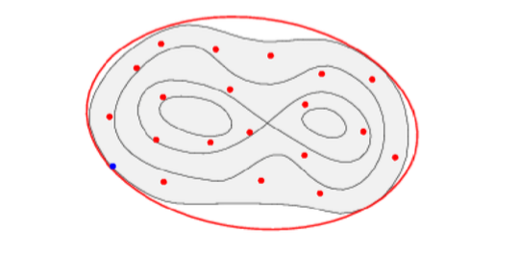
Sampling Step: Ellipsoid Fit
Simple MCMC (e.g. Metropolis-Hastings) works but can be inefficient
Mukherjee+06: Take advantage of the existing live points. Fit an ellipsoid to the live point, enlarge it sufficiently (to account for non-ellipsoidal shape), then sample from it using an exact method:
This works, but is problematic/inefficient for multi-modal likelihoods and/or strong, non-linear degeneracies between parameters.

Slide 34
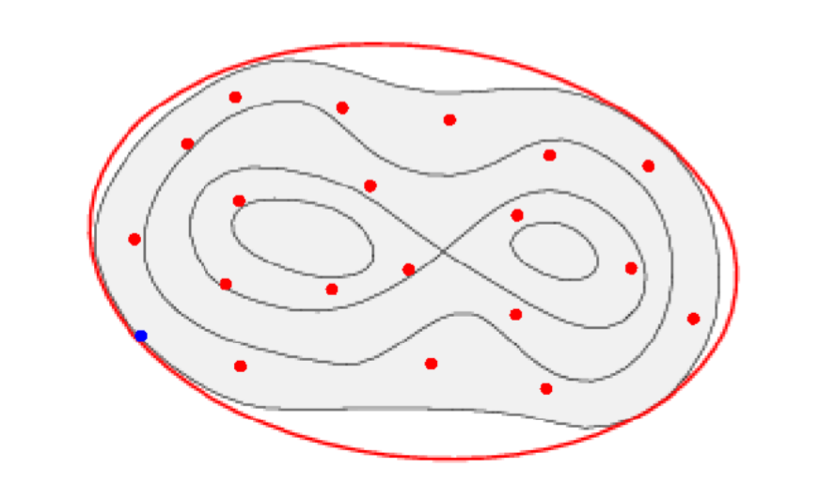
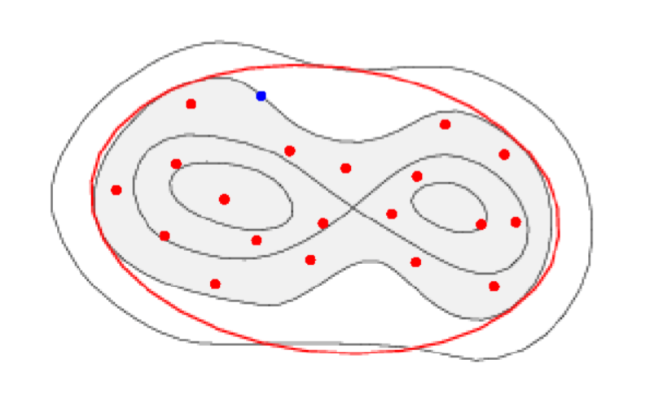
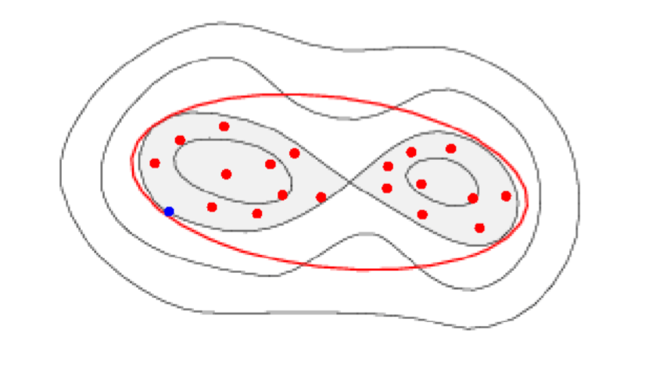
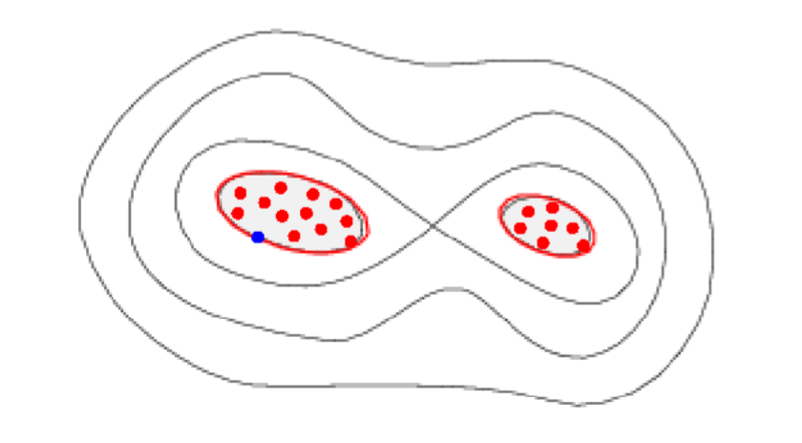
Sampling Step: Multimodal Sampling
Feroz&Hobson08; Feroz+08: At each nested sampling iteration
Partition active points into clusters
Construct ellipsoidal bounds to each cluster
Determine ellipsoid overlap
Remove point with lowest Li from active points; increment evidence.
Pick ellipsoid randomly and sample new point with L> Li accounting for overlaps
Each isolated cluster gives local evidence
Global evidence is the sum of the local evidences
This works, but is problematic/inefficient for multi-modal likelihoods and/or strong, non-linear degeneracies between parameters.

Slide 35
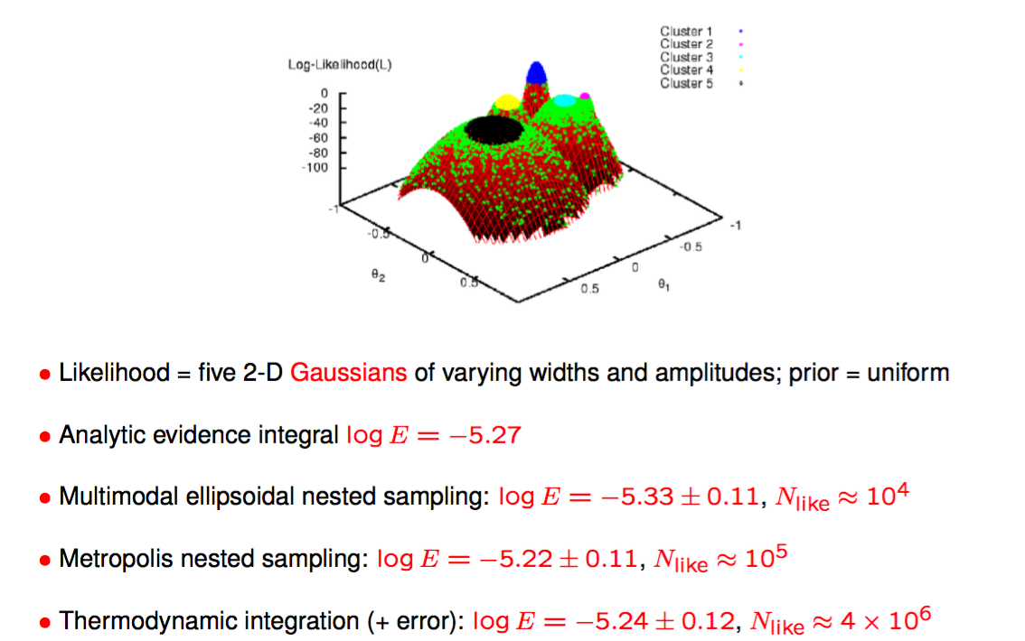
Test: Gaussian Mixture Model
(Slide courtesy of Mike Hobson)

Slide 36
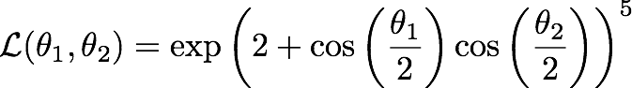
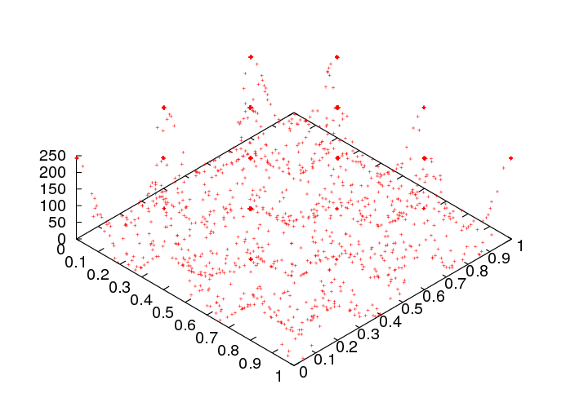
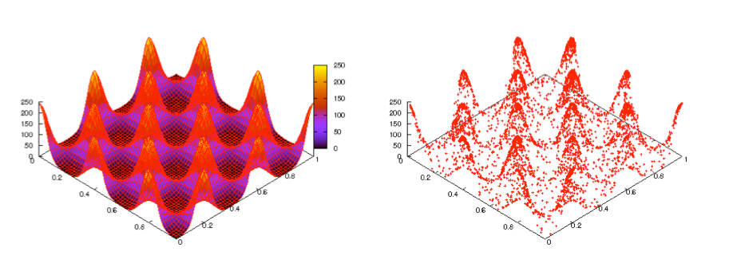
Test: Egg-Box Likelihood
(Animation: Farhan Feroz)
A more challenging example is the egg-box likelihood:
Prior:
Likelihood
Sampling (30k likelihood evaluations)

Slide 37
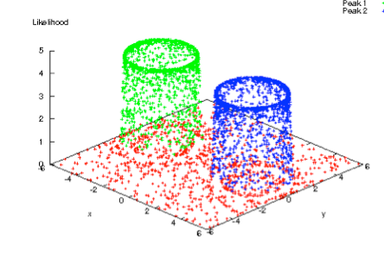
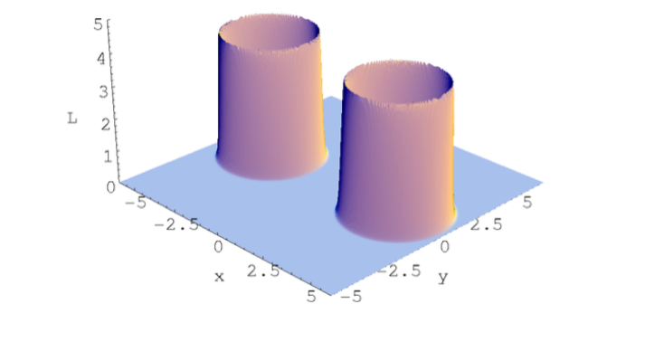
Test: Multiple Gaussian Shells
Courtesy Mike Hobson
Likelihood
Sampling
D | Nlike | Efficiency
2 | 7000 | 70%
5 | 18000 | 51%
10 | 53000 | 34%
20 | 255000 | 15%
30 | 753000 | 8%

Slide 38
Parallelisation and Efficiency
Sampling efficiency is less than unity since ellipsoidal approximation to the iso-likelihood contour is imperfect and ellipsoids may overlap
Parallel solution:
At each attempt to draw a replacement point, drawn NCPU candidates, with optimal number of CPUs given by 1/NCPU = efficiency
Limitations:
Performance improvement plateaus for NCPU >> 1/efficiency
For D>>30, small error in the ellipsoidal decomposition entails large drop in efficiency as most of the volume is near the surface
MultiNest thus (fundamentally) limited to D <= 30 dimensions

Slide 39
Neural Network Acceleration
Graff+12 (BAMBI) and Graff+14 (SkyNet); Johannesson,RT+16
A relatively straightforward idea: Use MultiNest discarded samples to train on-line a multi-layer Neural Network (NN) to learn the likelihood function.
Periodically test the accuracy of predictions: when the NN is ready, replace (possibly expensive) likelihood calls with (fast) NN prediction.
SkyNet: a feed-forward NN with N hidden layers, each with Mn nodes.
BAMBI (Blind Accelerated Multimodal Bayesian Inference): SkyNet integration with MultiNest
In cosmological applications, BAMBI typically accelerates the model likelihood computation by ~30% — useful, but not a game-changer.
Further usage of the resulted trained network (e.g. with different priors) delivers speed increases of a factor 4 to 50 (limited by error prediction calculation time).

Slide 40
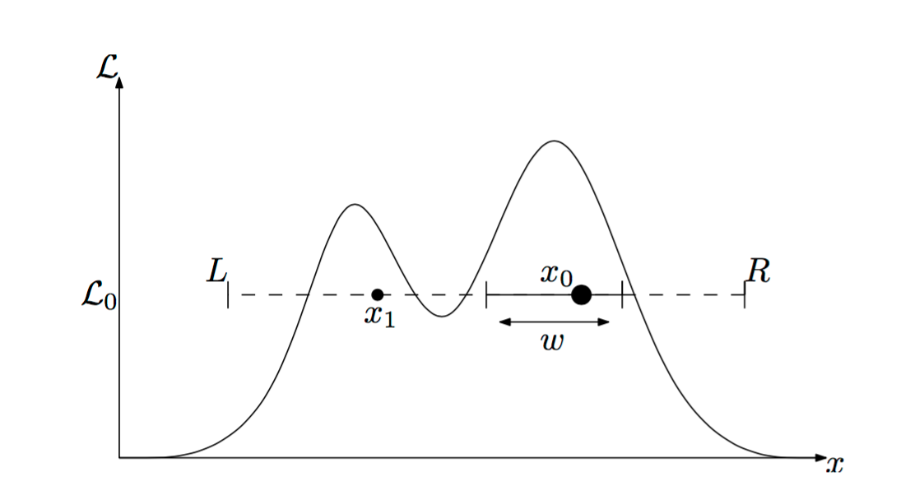
PolyChord: Nested Sampling in high-D
Handley et al, Mon.Not.Roy.Astron.Soc. 450 (2015)1, L61-L65
A new sampling step scheme is required to beat the limitations of the ellipsoidal decomposition at the heart of MultiNest
Slice Sampling (Neal00) in 1D:
Slice: All points with L(x)>L0
From starting point x0, set initial bounds L/R by expanding from a parameter w
Draw x1 randomly from within L/R
If x1 not in the slice, contract bound down to x1 and re-sample x1

Slide 41
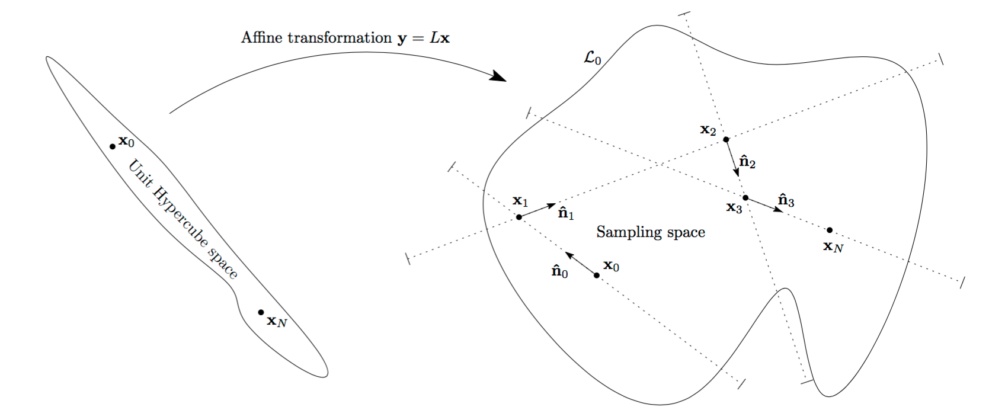
High-D Slice Sampling
A degenerate contour is transformed into a contour with dimensions of order O(1) in all directions (“whitening”)
Linear skew transform defined by the inverse of the Cholesky decomposition of the live points’ covariance matrix
Direction selected at random, then slice sampling in 1D performed (w=1)
Repeat N times, with N of order O(D), generating a new point xN decorrelated from x0
Handley+15

Slide 42

PolyChord: Performance
PolyChord number of likelihood evaluations scales at worst as O(D³) as opposed to exponential for MultiNest in high-D

Slide 43



Information Criteria
Several “information criteria” exist for approximate (and quick) model comparison
Define: k = number of fitted parameters N = number of data points -2 ln(Lmax) = best-fit chi-squared DKL = Kullback-Leibler divergence
Akaike Information Criterium (AIC):
Bayesian Information Criterium (BIC):
Deviance Information Criterium (DIC):

Slide 44
Notes on Information Criteria
The “best” model is the one which minimizes the AIC/BIC/DIC
Warning: AIC and BIC penalize models differently as a function of the number of data points, N: For N>7, BIC has a more strong penalty for models with a larger number of free parameters k.
BIC is an approximation to the full Bayesian evidence with a default Gaussian prior equivalent to 1/N-th of the data in the large N limit.
DIC takes into account whether parameters are measured or not (via the Bayesian complexity, see e.g M. Kunz, R. Trotta and D.R. Parkinson (2006), Phys. Rev. D 74, 023503 (2006), e-print archive: astro-ph/0602378).
Whenever possible, computation of the Bayesian evidence is preferable (with explicit prior specification).

Slide 45

How Many Sources?
Feroz and Hobson (2007)
Signal + Noise

Slide 46

How Many Sources?
Feroz and Hobson (2007)
Signal: 8 sources

Slide 47

How Many Sources?
Feroz and Hobson (2007)
Bayesian reconstruction
7 out of 8 objects correctly identified.
Mistake happens because 2 objects very close.

Slide 48

The Cosmological Concordance Model
from Trotta (2008)
lnB < 0: favours ΛCDM

Slide 49
Bayesian Hierarchical Models

Slide 50
Bayesian Hierarchical Models
Prior
Prior
Population parameters
Parameters of interest
Nuisance
parameters
INTRINSIC VARIABILITY
Latent variables
“True” values of observables
NOISE, SELECTION EFFECTS
Data
Observed values
Calibration data
Notes:
\mu_i = {m}_{B,i} - M_i + \alpha {x}_{1,i} - \beta {c}_i
M_i \sim \mathcal{N}(M_0, \sigma^2_\text{int})
c_i \sim \mathcal{N}(c_\star, R_c)
x_{1,i} \sim \mathcal{N}(x_\star, R_x)

Slide 51
Mathematical Formulation
The posterior distribution can be expanded in the usual Bayesian way:
p(params | data) ∝ p(data | params)p(params)
p(data|params) ∝ ∫p(data, true, pop | params) dtrue dpop
= ∫p(data | true) p(true | pop) p(pop) dtrue drop
Measurement errors
Intrinsic variability
Population-level priors
Notes:
M_i = {m}_{B,i} - \mu_i + \alpha {x}_{1,i} - \beta {c}_i
y_i = b + a x_i + \epsilon_i
x_i \sim p(x|\Psi) = \mathcal{N}_{x_i}(x_\star, R_x)

Slide 52


The Gaussian Linear Model
The “simple” problem of linear regression in the presence of measurement errors on both the dependent and independent variable and intrinsic scatter in the relationship (e.g., Gull 1989, Gelman et al 2004, Kelly 2007):
Model: unknown parameters of interest (a,b)
POPULATION DISTRIBUTION
INTRINSIC VARIABILITY
MEASUREMENT ERROR
Notes:
M_i = {m}_{B,i} - \mu_i + \alpha {x}_{1,i} - \beta {c}_i
y_i = b + a x_i + \epsilon_i
x_i \sim p(x|\Psi) = \mathcal{N}_{x_i}(x_\star, R_x)

Slide 53

Bayesian Hierarchical vs MLE
Rx = σx²/Var(x) = 1 in this example: Comparing the MLE (dashed) with the Bayesian Hierarchical Model Posterior (histogram)
Truth
Standard MLE (or Least Squares/Chi-Squared) fits are biased
(even if you artificially inflate the errors to get Chi-Squared/dof ~ 1)
Bayesian
MLE
Slope
Kelly, Astr. J., 665, 1489-1506 (2007)

Slide 54

Borrowing of Strength
Likelihood
Posterior
1st
2nd
3rd
4th
Intrinsic Magnitude
Colour correction
SNIa cosmology application:
Posterior estimates (red) exhibit smaller residual scatter when compared to the likelihood (blue), around the regression line: "borrowing of strength" (shrinkage) from the structure of the hierarchical model.
Shariff, RT+15, arxiv: 1510.05954

Slide 55


Cosmic Shear Reconstruction
Alsing, Heavens+(16) used a hierarchical Bayesian model to perform simultaneous reconstruction of the tomographic cosmic shear maps and its power spectra
Includes realistic (and complex) measurements effects like masking, PSF, pixelization, photo-z, etc.
Uses Gibbs+Messenger field as a sampling scheme for 67,000 params

Slide 56
Key Points
Bayesian model comparison extends parameter inference to the space of models
The Bayesian evidence (model likelihood) represents the change in the degree of belief in the model after we have seen the data
Models are rewarded for their predictivity (automatic Occam’s razor)
Prior specification is for model comparison a key ingredient of the model building step. If the prior cannot be meaningfully set, then the physics in the model is probably not good enough.
Bayesian model complexity can help (together with the Bayesian evidence) in assessing model performance.

